Slide 1
POCT “即时检验”
徐永康
2018年3月4日
Notes:
World Health Organization
This module deals with the very important topic of documentation. It is a half to one-day session (depending on the participants ability and experience) divided into 2 roughly equal parts:
In each half, there will be 30 - 45 minutes of presentation, 45 minutes discussion in groups and 30 minutes feedback to the whole group. There will be one test and discussion (40 minutes) covering the whole module that will be taken at the end.

Slide 2
目录
一.POCT概述
二.POCT特点
三.POCT技术平台
四.POCT-CRP应用

Slide 3
POCT概述
Notes:
World Health Organization
This module deals with the very important topic of documentation. It is a half to one-day session (depending on the participants ability and experience) divided into 2 roughly equal parts:
In each half, there will be 30 - 45 minutes of presentation, 45 minutes discussion in groups and 30 minutes feedback to the whole group. There will be one test and discussion (40 minutes) covering the whole module that will be taken at the end.

Slide 4
POCT概述
POCT定义（point of care testing）
即时检测，指在患者旁边进行的临床检测，俗称“床边检测”，可以省去标本在实验室检测时的复杂处理程序，快速取得检验结果。
Notes:
World Health Organization
This module deals with the very important topic of documentation. It is a half to one-day session (depending on the participants ability and experience) divided into 2 roughly equal parts:
In each half, there will be 30 - 45 minutes of presentation, 45 minutes discussion in groups and 30 minutes feedback to the whole group. There will be one test and discussion (40 minutes) covering the whole module that will be taken at the end.

Slide 5
POCT概述
应用领域
POCT因为快速、便捷的特点，被广泛应用于各种医疗和生活场景。根据POCT产品的不同应用领域，分为以下八大类。
Notes:
World Health Organization
This module deals with the very important topic of documentation. It is a half to one-day session (depending on the participants ability and experience) divided into 2 roughly equal parts:
In each half, there will be 30 - 45 minutes of presentation, 45 minutes discussion in groups and 30 minutes feedback to the whole group. There will be one test and discussion (40 minutes) covering the whole module that will be taken at the end.

Slide 6
POCT概述
应用领域
POCT因为快速、便捷的特点，被广泛应用于各种医疗和生活场景。根据POCT产品的不同应用领域，分为以下八大类。
Notes:
World Health Organization
This module deals with the very important topic of documentation. It is a half to one-day session (depending on the participants ability and experience) divided into 2 roughly equal parts:
In each half, there will be 30 - 45 minutes of presentation, 45 minutes discussion in groups and 30 minutes feedback to the whole group. There will be one test and discussion (40 minutes) covering the whole module that will be taken at the end.

Slide 7
Notes:
World Health Organization
This module deals with the very important topic of documentation. It is a half to one-day session (depending on the participants ability and experience) divided into 2 roughly equal parts:
In each half, there will be 30 - 45 minutes of presentation, 45 minutes discussion in groups and 30 minutes feedback to the whole group. There will be one test and discussion (40 minutes) covering the whole module that will be taken at the end.

Slide 8
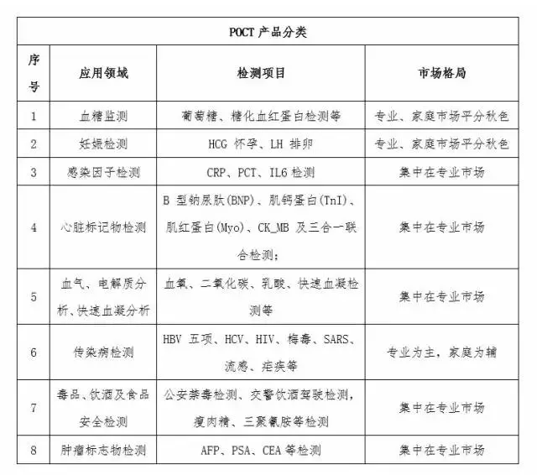
Notes:
World Health Organization
This module deals with the very important topic of documentation. It is a half to one-day session (depending on the participants ability and experience) divided into 2 roughly equal parts:
In each half, there will be 30 - 45 minutes of presentation, 45 minutes discussion in groups and 30 minutes feedback to the whole group. There will be one test and discussion (40 minutes) covering the whole module that will be taken at the end.

Slide 9
POCT概述
根据Rncos 2014年5约发布的《Global point-of-Care Diagnostics Market Outlook 2018》,2013年全球POCT市场规模达到160亿美元，预计在2013-2018年间将保持8%的复合增长率。据业内人士介绍，2015年我国POCT市场规模约70～80亿人民币，年复合增长率超过20%。
Notes:
World Health Organization
This module deals with the very important topic of documentation. It is a half to one-day session (depending on the participants ability and experience) divided into 2 roughly equal parts:
In each half, there will be 30 - 45 minutes of presentation, 45 minutes discussion in groups and 30 minutes feedback to the whole group. There will be one test and discussion (40 minutes) covering the whole module that will be taken at the end.

Slide 10
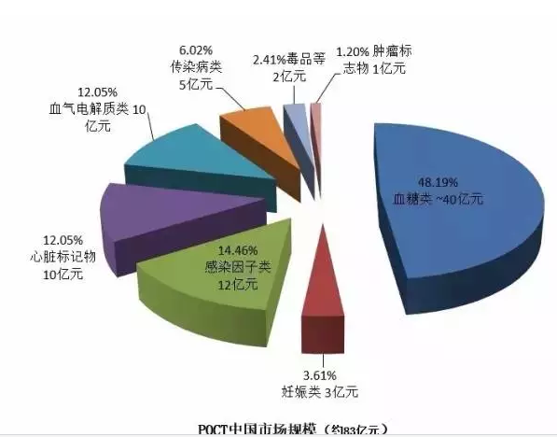
POCT概述
Notes:
World Health Organization
This module deals with the very important topic of documentation. It is a half to one-day session (depending on the participants ability and experience) divided into 2 roughly equal parts:
In each half, there will be 30 - 45 minutes of presentation, 45 minutes discussion in groups and 30 minutes feedback to the whole group. There will be one test and discussion (40 minutes) covering the whole module that will be taken at the end.

Slide 11
POCT概述
1.血糖检测
市场最成熟，随着进口替代以及渗透率提升仍将带来可观增长
主要包括：血糖检测系统（仪器以及试剂），糖化血红蛋白定量检测试剂。
目前中国血糖仪市场约35亿人民币(医用+家用)，外资占据60%以上市场份额，国内企业在30%多的市场份额中，
目前国内主流血糖仪已经采用主流的电化学法。随着技术进步，国产血糖仪厂商不仅可以提供可靠的检测数据，还能提供优质的服务和高性价比的价格，进口替代效应日趋明显。
当然，未来的技术发展趋势将往无创检测和连续动态检测发展。
Notes:
World Health Organization
This module deals with the very important topic of documentation. It is a half to one-day session (depending on the participants ability and experience) divided into 2 roughly equal parts:
In each half, there will be 30 - 45 minutes of presentation, 45 minutes discussion in groups and 30 minutes feedback to the whole group. There will be one test and discussion (40 minutes) covering the whole module that will be taken at the end.

Slide 12
POCT概述
2.妊娠检测
市场准入门槛低，竞争者多，已有细分龙头出现
主要包括HCG（人绒毛膜促性腺激素）检测、LH（促黄体激素）检测、FSH（促卵泡激素）检测。
HCG可以在受孕的妇女尿液中检测，是早期检测怀孕的最好标志；
LH通过尿液检测，是预测排卵的可靠指标；
FSH通过尿液检测，是预测排卵的可靠指标。
公司 | 销售额（亿元） | 市场占有率（估算） | 备注
广州万孚 | ~2 | 66%
其他 | ~1 | 34%
Notes:
World Health Organization
This module deals with the very important topic of documentation. It is a half to one-day session (depending on the participants ability and experience) divided into 2 roughly equal parts:
In each half, there will be 30 - 45 minutes of presentation, 45 minutes discussion in groups and 30 minutes feedback to the whole group. There will be one test and discussion (40 minutes) covering the whole module that will be taken at the end.

Slide 13
POCT概述
3.感染因子检测
鉴别细菌或者病毒感染的CRP（C-反应蛋白）和PCT（降钙素原）快速定量检测系统，目前市场规模12亿元（主要是CRP和PCT），增长率30%。
_{此行业增长的原因主要有以下两点：}
1）政府限抗：政府大力推动限制抗生素使用，使得鉴别细菌或者病毒感染的市场急剧放量，行业连续保持超30%的高速增长；
2）医院认可：医院已将CRP检测的地位与血常规相提并论，PCT在医院的用量增速超过40%，为感染因子检测市场长期发展带来了巨大的机遇。
Notes:
World Health Organization
This module deals with the very important topic of documentation. It is a half to one-day session (depending on the participants ability and experience) divided into 2 roughly equal parts:
In each half, there will be 30 - 45 minutes of presentation, 45 minutes discussion in groups and 30 minutes feedback to the whole group. There will be one test and discussion (40 minutes) covering the whole module that will be taken at the end.

Slide 14
POCT概述
_{4.心脏标志物检测}
主要用于常见心血管疾病（心梗、心衰等）的快速定量或定性检测筛查。市场规模约10 亿元，增速约30%。心脏标识物行业大医院市场主要被进口占据，罗氏和Alere 市场占有率最高，产品技术路径主要是小型化学发光和免疫荧光定量。
国产产品2011年至今超快速增长，在中小医院市场占有率较高，产品技术路径以免疫层析+胶体金为主，市场占有率较高的是南京基蛋和深圳瑞莱。心脏标志物产品竞争力的关键在于检测指标的多少、检测时间的长短以及检测准确度。我国企业在方法学批间差方面存在较大的技术差距，技术的提升对提高竞争力起着非常重要的作用。
Notes:
World Health Organization
This module deals with the very important topic of documentation. It is a half to one-day session (depending on the participants ability and experience) divided into 2 roughly equal parts:
In each half, there will be 30 - 45 minutes of presentation, 45 minutes discussion in groups and 30 minutes feedback to the whole group. There will be one test and discussion (40 minutes) covering the whole module that will be taken at the end.

Slide 15
POCT概述
5.血气、电解质检测
血气、电解质分析，广泛应用在重症监护病房、急诊室、手术室、呼吸科、康复室或透析病房。
血气分析是指分析血液中所含的O2 和CO2 气体，是评价病人呼吸、氧化及酸碱平衡状态的必要指标。电解质分析仪可反映病人体内急性和潜在的酸碱平衡和气体交换的内环境变化，血清K+、Na+、Cl-离子测定也是临床上常用的检测项目和急诊项目之一。
中国市场约10 亿人民币，增长率25％。国际品牌如：RadioMeter、雅培、罗氏、西门子。国内血气电解质市场主要依赖于大型传统设备，而POCT 市场则几乎完全被外资企业垄断。
Notes:
World Health Organization
This module deals with the very important topic of documentation. It is a half to one-day session (depending on the participants ability and experience) divided into 2 roughly equal parts:
In each half, there will be 30 - 45 minutes of presentation, 45 minutes discussion in groups and 30 minutes feedback to the whole group. There will be one test and discussion (40 minutes) covering the whole module that will be taken at the end.

Slide 16
POCT概述
6.传染病检测类
主要针对各类常见传染病及重大传染病等基层现场筛查、快速检测的产品，包括艾滋病、梅毒、病毒性肝炎（甲肝、乙肝、丙肝、戊肝）、疟疾、流感等传染病的快速检测产品。目前国内5-6亿元市场规模，市场主要集中在基层医疗机构、社区门诊和疾控等。
Notes:
World Health Organization
This module deals with the very important topic of documentation. It is a half to one-day session (depending on the participants ability and experience) divided into 2 roughly equal parts:
In each half, there will be 30 - 45 minutes of presentation, 45 minutes discussion in groups and 30 minutes feedback to the whole group. There will be one test and discussion (40 minutes) covering the whole module that will be taken at the end.

Slide 17
POCT概述
7.毒品（药物滥用）检测类
主要以金标法进行尿液或唾液检测为主的定性类产品居多，广泛适用于戒毒所、医院、军队征兵、海关边检、特种行业和招工体检的筛查工作。在我国征兵检测领域，自2006年起增加了吸食毒品的检测，为药物滥用类POCT提供了稳定的市场。
Notes:
World Health Organization
This module deals with the very important topic of documentation. It is a half to one-day session (depending on the participants ability and experience) divided into 2 roughly equal parts:
In each half, there will be 30 - 45 minutes of presentation, 45 minutes discussion in groups and 30 minutes feedback to the whole group. There will be one test and discussion (40 minutes) covering the whole module that will be taken at the end.

Slide 18
POCT概述
8.肿瘤类产品
肿瘤类产品主要为常见的肿瘤标志物检测，包括甲胎蛋白（AFP）、癌胚抗原（CEA）、前列腺特异性抗原（PSA）检测等。由于肿瘤标识物对应急性的要求相对不高，其POCT 市场相对不大，国内企业相对较少进入。
Notes:
World Health Organization
This module deals with the very important topic of documentation. It is a half to one-day session (depending on the participants ability and experience) divided into 2 roughly equal parts:
In each half, there will be 30 - 45 minutes of presentation, 45 minutes discussion in groups and 30 minutes feedback to the whole group. There will be one test and discussion (40 minutes) covering the whole module that will be taken at the end.

Slide 19
POCT特点
Notes:
World Health Organization
This module deals with the very important topic of documentation. It is a half to one-day session (depending on the participants ability and experience) divided into 2 roughly equal parts:
In each half, there will be 30 - 45 minutes of presentation, 45 minutes discussion in groups and 30 minutes feedback to the whole group. There will be one test and discussion (40 minutes) covering the whole module that will be taken at the end.

Slide 20
POCT特点
Notes:
World Health Organization
This module deals with the very important topic of documentation. It is a half to one-day session (depending on the participants ability and experience) divided into 2 roughly equal parts:
In each half, there will be 30 - 45 minutes of presentation, 45 minutes discussion in groups and 30 minutes feedback to the whole group. There will be one test and discussion (40 minutes) covering the whole module that will be taken at the end.

Slide 21
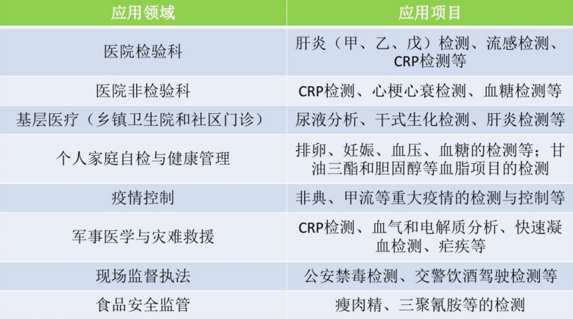
POCT特点
POCT定义（point of care testing）
即时检测，指在患者旁边进行的临床检测，俗称“床边检测”，可以省去标本在实验室检测时的复杂处理程序，快速取得检验结果。
Notes:
World Health Organization
This module deals with the very important topic of documentation. It is a half to one-day session (depending on the participants ability and experience) divided into 2 roughly equal parts:
In each half, there will be 30 - 45 minutes of presentation, 45 minutes discussion in groups and 30 minutes feedback to the whole group. There will be one test and discussion (40 minutes) covering the whole module that will be taken at the end.

Slide 22
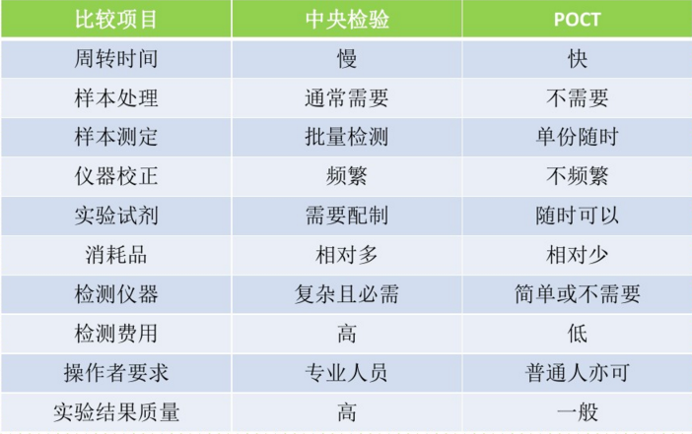
POCT特点
POCT定义（point of care testing）
即时检测，指在患者旁边进行的临床检测，俗称“床边检测”，可以省去标本在实验室检测时的复杂处理程序，快速取得检验结果。
Notes:
World Health Organization
This module deals with the very important topic of documentation. It is a half to one-day session (depending on the participants ability and experience) divided into 2 roughly equal parts:
In each half, there will be 30 - 45 minutes of presentation, 45 minutes discussion in groups and 30 minutes feedback to the whole group. There will be one test and discussion (40 minutes) covering the whole module that will be taken at the end.

Slide 23
POCT技术平台
Notes:
World Health Organization
This module deals with the very important topic of documentation. It is a half to one-day session (depending on the participants ability and experience) divided into 2 roughly equal parts:
In each half, there will be 30 - 45 minutes of presentation, 45 minutes discussion in groups and 30 minutes feedback to the whole group. There will be one test and discussion (40 minutes) covering the whole module that will be taken at the end.

Slide 24
POCT技术平台
POCT技术的基本原理大致可分为四类：
（1）把传统方法中的相关液体试剂浸润于滤纸和各种微孔膜的吸水材料内，成为整合的干燥试剂块，然后将其固定于硬质型基质上，成为各种形式的诊断试剂条。
（2）把传统分析仪器微型化，操作方法简单化，使之成为便携式和手掌式的设备。
（3）把上述二者整合为统一的系统。
（4）应用生物感应技术，利用生物感应器检测待测物。
Notes:
World Health Organization
This module deals with the very important topic of documentation. It is a half to one-day session (depending on the participants ability and experience) divided into 2 roughly equal parts:
In each half, there will be 30 - 45 minutes of presentation, 45 minutes discussion in groups and 30 minutes feedback to the whole group. There will be one test and discussion (40 minutes) covering the whole module that will be taken at the end.

Slide 25
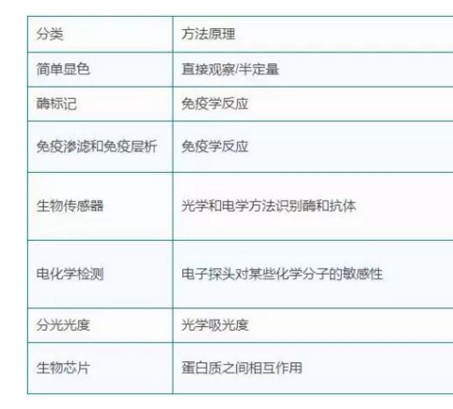
POCT技术平台
POCT技术的基本原理大致可分为四类：
（1）把传统方法中的相关液体试剂浸润于滤纸和各种微孔膜的吸水材料内，成为整合的干燥试剂块，然后将其固定于硬质型基质上，成为各种形式的诊断试剂条。
（2）把传统分析仪器微型化，操作方法简单化，使之成为便携式和手掌式的设备。
（3）把上述二者整合为统一的系统。
（4）应用生物感应技术，利用生物感应器检测待测物。
Notes:
World Health Organization
This module deals with the very important topic of documentation. It is a half to one-day session (depending on the participants ability and experience) divided into 2 roughly equal parts:
In each half, there will be 30 - 45 minutes of presentation, 45 minutes discussion in groups and 30 minutes feedback to the whole group. There will be one test and discussion (40 minutes) covering the whole module that will be taken at the end.

Slide 26
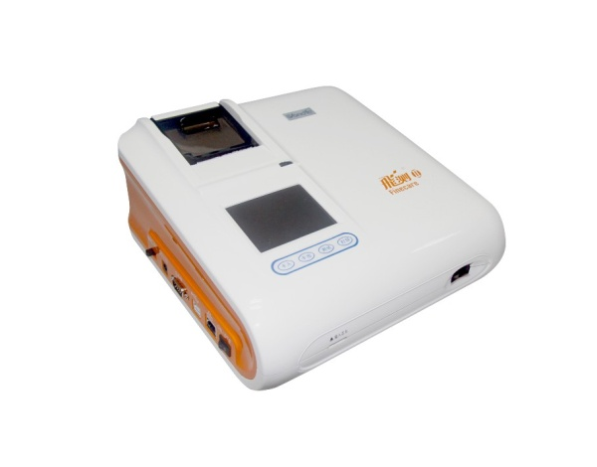
POCT技术平台
POCT技术的基本原理大致可分为四类：
（1）把传统方法中的相关液体试剂浸润于滤纸和各种微孔膜的吸水材料内，成为整合的干燥试剂块，然后将其固定于硬质型基质上，成为各种形式的诊断试剂条。
（2）把传统分析仪器微型化，操作方法简单化，使之成为便携式和手掌式的设备。
（3）把上述二者整合为统一的系统。
（4）应用生物感应技术，利用生物感应器检测待测物。
Notes:
World Health Organization
This module deals with the very important topic of documentation. It is a half to one-day session (depending on the participants ability and experience) divided into 2 roughly equal parts:
In each half, there will be 30 - 45 minutes of presentation, 45 minutes discussion in groups and 30 minutes feedback to the whole group. There will be one test and discussion (40 minutes) covering the whole module that will be taken at the end.

Slide 27
POCT技术平台
一、干化学技术
干化学技术是将多种反应试剂，干燥在纸片上，用被测样品中所存在的液体作反应介质，被测成分直接与固化于载体上的干试剂进行反应。加上检验标本后产生颜色反应，用眼观定性或仪器检测（半定量）。适用于全血，血清，血浆，尿液等各类样品。
Notes:
World Health Organization
This module deals with the very important topic of documentation. It is a half to one-day session (depending on the participants ability and experience) divided into 2 roughly equal parts:
In each half, there will be 30 - 45 minutes of presentation, 45 minutes discussion in groups and 30 minutes feedback to the whole group. There will be one test and discussion (40 minutes) covering the whole module that will be taken at the end.

Slide 28
POCT技术平台
二、多层涂膜技术
多层涂膜技术是从感光胶片制作技术移植而来。将多种反应试剂依次涂布在片基上，制成干片。采用多层涂膜技术制成的干片，比干化学纸片平整均匀，用仪器检测，可以准确定量，如目前临床使用的干板化学分析系统，可用于大多数血液化学成分，如蛋白质、糖类、脂类、酶、电解质、非蛋白氮类及一些血药浓度的监测，可供检测的项目达数十项，几乎覆盖了常做的临床生化检验项目。由于其操作简便、快速、常用于急诊检查，也相应推出了一些小型仪器，可做床边检验，但干片成本较高。
Notes:
World Health Organization
This module deals with the very important topic of documentation. It is a half to one-day session (depending on the participants ability and experience) divided into 2 roughly equal parts:
In each half, there will be 30 - 45 minutes of presentation, 45 minutes discussion in groups and 30 minutes feedback to the whole group. There will be one test and discussion (40 minutes) covering the whole module that will be taken at the end.

Slide 29
POCT技术平台
三、免疫层析、色谱法
POCT条带技术能用于测定蛋白质和酶，如心肌标志物，激素和各种蛋白质等，多为定性试验。基质中分析物的分离是通过纸层析法完成的，并且凭借固定在层析带表面的特异性抗体捕获目标分析物，用于定性分析，这种检测可通过观察颜色完成。
Notes:
World Health Organization
This module deals with the very important topic of documentation. It is a half to one-day session (depending on the participants ability and experience) divided into 2 roughly equal parts:
In each half, there will be 30 - 45 minutes of presentation, 45 minutes discussion in groups and 30 minutes feedback to the whole group. There will be one test and discussion (40 minutes) covering the whole module that will be taken at the end.

Slide 30
POCT技术平台
胶体金技术也属于POCT的范畴，胶体金、银、硒及色素（包括荧光色素和非荧光色素）可以牢固吸附在抗体的表面而不影响抗体的活性，当标记抗体与抗原反应聚集到一定浓度时，可以直接呈现颜色。目前，金、银、硒及色素标记免疫反应的方法主要有斑点渗滤法和免疫层析法，用于快速检测蛋白质类和多肽类抗原，如cTnT、血清白蛋白、hs-CRP及一些病毒如HBV、HCV、HIV等的抗原和抗体定性。配合小型检测仪，可做半定量和定量。
目前，有些公司采用免疫层析双抗原、双抗体夹心法原理，结合胶体金标记技术相继开发了生殖内分泌、传染性疾病、性病、肿瘤标志物、毒品等类几十项，近百种规格的胶体金检测试产品。如HCG测试卡，HBV测试卡等。
Notes:
World Health Organization
This module deals with the very important topic of documentation. It is a half to one-day session (depending on the participants ability and experience) divided into 2 roughly equal parts:
In each half, there will be 30 - 45 minutes of presentation, 45 minutes discussion in groups and 30 minutes feedback to the whole group. There will be one test and discussion (40 minutes) covering the whole module that will be taken at the end.

Slide 31
POCT技术平台
四、选择性电极技术
用离子选择性电极结合传感器包括生物传感器和化学传感器技术，制成了便携式快速检测血气（PH、PCO2、PO2等）和电解质（K+、Na+、Cl-等）的仪器，已被广泛应用于临床。
Notes:
World Health Organization
This module deals with the very important topic of documentation. It is a half to one-day session (depending on the participants ability and experience) divided into 2 roughly equal parts:
In each half, there will be 30 - 45 minutes of presentation, 45 minutes discussion in groups and 30 minutes feedback to the whole group. There will be one test and discussion (40 minutes) covering the whole module that will be taken at the end.

Slide 32
POCT技术平台
五、红外和远红外分光光度技术
常用于制作经皮检测仪器，可用于检测血液血红蛋白、胆红素、葡萄糖等多种成分。这类检测仪器可连续监测病人血液中的目的成分，无需抽血，这可以避免抽血可能引起的交叉感染和血液标本的污染，降低每次检验的成本和缩短报告时间。但是，这类经皮检测结果的准确性有待提高。
Notes:
World Health Organization
This module deals with the very important topic of documentation. It is a half to one-day session (depending on the participants ability and experience) divided into 2 roughly equal parts:
In each half, there will be 30 - 45 minutes of presentation, 45 minutes discussion in groups and 30 minutes feedback to the whole group. There will be one test and discussion (40 minutes) covering the whole module that will be taken at the end.

Slide 33
POCT技术平台
六、生物传感器
新一代POCT仪使用生物传感器。一个生物传感器偶联一个特定的生物检测器（如酶、抗体或核酸探针）到一个换能器用于靶分析物的直接测定而无需从基质中分离它。它体现了酶化学、免疫化学、电化学与计算机技术的结合。应用它可以对生物体液中的分析物进行超微量的分析，成为检验医学的最佳框架。例如电解质的检测。商业的POCT仪器用电化学技术（如微型离子选择电极）和光学生物传感器去测定葡萄糖，电解质和动脉血气。随着抗体固定技术和特异DNA序列的应用，生物传感器探针将很快用于检测激素、药物、难于培养的细菌、病毒如衣原体、结核菌、人类免疫缺陷病毒。
Notes:
World Health Organization
This module deals with the very important topic of documentation. It is a half to one-day session (depending on the participants ability and experience) divided into 2 roughly equal parts:
In each half, there will be 30 - 45 minutes of presentation, 45 minutes discussion in groups and 30 minutes feedback to the whole group. There will be one test and discussion (40 minutes) covering the whole module that will be taken at the end.

Slide 34
POCT技术平台
七、生物芯片
生物芯片是利用上世纪末提出的以微电加工技术为基础的微全分析系统的概念，将所有试样处理及测定步骤合并于一体，分析人员可在很短时间和空间间隔内获取电信号形式表达的化学信息。
目前生物芯片可分为基因芯片（Gene chip或DNA chip）、蛋白质芯片（protein chip）、细胞芯片（cell chip）和芯片实验室（Lab-On-a-Chip，LOC），它们具有高灵敏度、分析时间短、同时分析项目多等优点
Notes:
World Health Organization
This module deals with the very important topic of documentation. It is a half to one-day session (depending on the participants ability and experience) divided into 2 roughly equal parts:
In each half, there will be 30 - 45 minutes of presentation, 45 minutes discussion in groups and 30 minutes feedback to the whole group. There will be one test and discussion (40 minutes) covering the whole module that will be taken at the end.

Slide 35
CRP应用及临床价值
Notes:
World Health Organization
This module deals with the very important topic of documentation. It is a half to one-day session (depending on the participants ability and experience) divided into 2 roughly equal parts:
In each half, there will be 30 - 45 minutes of presentation, 45 minutes discussion in groups and 30 minutes feedback to the whole group. There will be one test and discussion (40 minutes) covering the whole module that will be taken at the end.

Slide 36
POCT-CRP应用及临床价值
C-反应蛋白定义：
CRP是机体受到微生物入侵或组织损伤等炎症性刺激时肝细胞合成的急性相关蛋白
CRP在健康人血清中浓度很低（<10mg/L），而在细菌感染或组织损伤时，其浓度显著升高，故被认为其最有价值。
Notes:
World Health Organization
This module deals with the very important topic of documentation. It is a half to one-day session (depending on the participants ability and experience) divided into 2 roughly equal parts:
In each half, there will be 30 - 45 minutes of presentation, 45 minutes discussion in groups and 30 minutes feedback to the whole group. There will be one test and discussion (40 minutes) covering the whole module that will be taken at the end.

Slide 37
POCT-CRP应用及临床价值
CRP升高的程度反应炎症组织的大小或活动性，在急性炎症和感染时，CRP与疾病活动性有良好的相关性。这种情况与慢性炎症不相符，尽管在一些重要情况下，如类风湿关节炎、节段性回肠炎和风湿性多肌痛时，这种相关性足以用来作为治疗监测。
1、CRP值为10-50mg/L表示轻度炎症，例如局部细菌性感染（如膀胱炎、支气管炎、脓肿）、手术和意外创伤、心肌梗死、深静脉血栓、非活动性结缔组织病、许多恶性肿瘤和多数病毒感染。
2、CRP值升为100mg/L左右表示较严重的疾病，它的炎症程度必要时需静脉注射。
3、CRP值大于100mg/L，表示严重的疾病过程并常表示细菌感染的存在。
Notes:
World Health Organization
This module deals with the very important topic of documentation. It is a half to one-day session (depending on the participants ability and experience) divided into 2 roughly equal parts:
In each half, there will be 30 - 45 minutes of presentation, 45 minutes discussion in groups and 30 minutes feedback to the whole group. There will be one test and discussion (40 minutes) covering the whole module that will be taken at the end.

Slide 38
POCT-CRP应用及临床价值
产品定位
发热待查首选检查指标，最适合儿科及门诊即时检测、指导抗生素使用最经济的首选筛查项目；
适用范围
儿科、门诊、检验科、ICU、感染科、心内科等
Notes:
World Health Organization
This module deals with the very important topic of documentation. It is a half to one-day session (depending on the participants ability and experience) divided into 2 roughly equal parts:
In each half, there will be 30 - 45 minutes of presentation, 45 minutes discussion in groups and 30 minutes feedback to the whole group. There will be one test and discussion (40 minutes) covering the whole module that will be taken at the end.

Slide 39
POCT-CRP应用
POCT-CRP应用及临床价值
CRP是急性时相反应的“金指标”
在炎症、组织损伤和手术后, CRP浓度显著增高
疾病后4—6h开始升高，6-12小时就可检测到血液中升高的CRP，24—48h达到高峰
比正常值高100～1000倍，升高幅度与感染的程度呈正相关，持续时间与病程相当
病变好转时其含量急速下降，1周内可恢复正常（T_{1/2}约19 h)，
变化不受患者的个体差异、机体状态和治疗药物的影响
时相性+灵敏性+临床特异性
Notes:
World Health Organization
This module deals with the very important topic of documentation. It is a half to one-day session (depending on the participants ability and experience) divided into 2 roughly equal parts:
In each half, there will be 30 - 45 minutes of presentation, 45 minutes discussion in groups and 30 minutes feedback to the whole group. There will be one test and discussion (40 minutes) covering the whole module that will be taken at the end.

Slide 40
常用感染指标的比较 细菌或病毒感染鉴别的特异性、灵敏性：CRP＞WBC＞ESR
 | C-反应蛋白（CRP） | 白细胞（WBC） | 血沉（ESR）
对急性炎症的反应 出现升高、消退时间 | CRP浓度在炎症进程开始后 4～6h明显上升；36h～50h达高峰（可为正常值的100倍～1000倍），当感染被控制后血的CRP水平迅速下降 | wbc升高较慢，在炎症早期WBC不如CRP出现的快；治疗后变化缓慢* | 一般2～3d才开始升高,有效治疗后,血沉几周后仍不降至正常
影响因素 | 不受病人的个体差异、机体状态和治疗药物的影响 | 易受年龄、日间变化、妊娠与分娩、机体抵抗力、药物治疗等多种混杂因素的影响 ,解热镇痛药、抗生素均可使WBC降低 | 易受年龄、性别、温度、贫血、血沉管位置、药物等因素影响
相关疾病的活动性 （细菌感染） | CRP量的动态变化能反应疾病的活动性* 在细菌感染时增高,而病毒感染时不增高 升高的幅度与细菌感染的程度呈正相关 不受抗生素、免疫抑制剂和激素的影响,直到炎症吸收CRP才恢复正常 | wbc量的变化不能反应疾病的活动性* WBC正常范围较宽，一些WBC基数低的患儿，轻度升高不会超过正常范围上限； 部分细菌感染时，患儿WBC不能相应提高，WBC计数及分类指数变化不显著 | 无相关性 间接测量纤维蛋白的水平,但其变化范围在病人与健康人之间交叉较大,因而对其正常结果的制定受到影响
细菌或病毒感染鉴别 | 能（显著性差异） | 不易（部分差异不显著） 不是可靠指标，尤其是小婴儿 | 不能（无显著差异）
血培养：至少需要48h，结果滞后，且阳性率低，标本易污染；血培养阴性也不能完全排除败血症
Notes:
World Health Organization
This module deals with the very important topic of documentation. It is a half to one-day session (depending on the participants ability and experience) divided into 2 roughly equal parts:
In each half, there will be 30 - 45 minutes of presentation, 45 minutes discussion in groups and 30 minutes feedback to the whole group. There will be one test and discussion (40 minutes) covering the whole module that will be taken at the end.

Slide 41
POCT-CRP应用及临床价值
抗生素使用的主要人群之一是15岁以下儿童，据上海、北京和重庆儿童医院资 料
门诊就诊患儿已使用抗生素者80～85％（呼吸道感染占儿科疾病发病率的首位 ，占儿科门诊总数的90% ，大多数都有发烧、咳嗽的表现 ，90%以上的呼吸道感染是由病毒引起，用抗生素无效 ）
普通感冒92～98％——普通感冒90％是病毒所致，不适合用抗生素
肺炎者则100％使用抗生素——婴幼儿肺炎尤其初始阶段，病毒病原比率也高达40％，这部分患儿是没有使用抗生素指征的
Notes:
World Health Organization
This module deals with the very important topic of documentation. It is a half to one-day session (depending on the participants ability and experience) divided into 2 roughly equal parts:
In each half, there will be 30 - 45 minutes of presentation, 45 minutes discussion in groups and 30 minutes feedback to the whole group. There will be one test and discussion (40 minutes) covering the whole module that will be taken at the end.

Slide 42
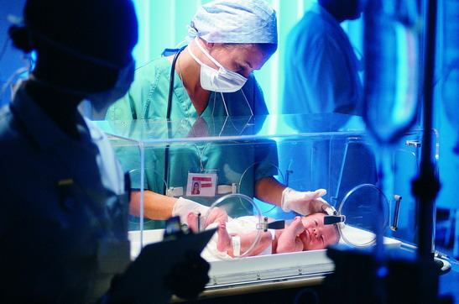
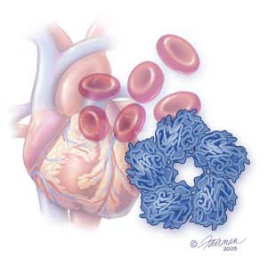
POCT-CRP应用及临床价值
CRP的临床价值
hs CRP ＞2mg/L提示新生儿感染
新生儿hs CRP参考范围为< 1～2mg/L，超出此范围与严重感染有关¹
hs—CRP用于心血管疾病危险评估时²，
＜1.0mg/L：低危险性；
1.0mg/L～ 3.0mg/L：中度危险性
＞3.0mg/L：高度危险性
常规CRP：感染的鉴别诊断
Notes:
World Health Organization
This module deals with the very important topic of documentation. It is a half to one-day session (depending on the participants ability and experience) divided into 2 roughly equal parts:
In each half, there will be 30 - 45 minutes of presentation, 45 minutes discussion in groups and 30 minutes feedback to the whole group. There will be one test and discussion (40 minutes) covering the whole module that will be taken at the end.

Slide 43
POCT-CRP应用及临床价值
CRP的临床价值
 | 范围 mg/L | 灵敏度 mg/L | 感染性疾病 |  |  | 心血管疾病危险评估
 |  |  | 新生儿 | 儿童 | 成人 | 成人
常规CRP | 5～160 | 1 |  | √ | √
hsCRP | 0.5～5 | 0.1 | √ |  |  | √
全程CRP | 0.5～200 | 0.1 | √ | √ | √ | √
全程CRP
一卡双项：包含hsCRP和常规CRP的检测范围
更准确的检测低水平的CRP：检测低限为0.5mg/L
更敏感的检测CRP微小变化：检测灵敏度为0.1mg/L
应用更广：全量程0.5～200mg/L
Notes:
World Health Organization
This module deals with the very important topic of documentation. It is a half to one-day session (depending on the participants ability and experience) divided into 2 roughly equal parts:
In each half, there will be 30 - 45 minutes of presentation, 45 minutes discussion in groups and 30 minutes feedback to the whole group. There will be one test and discussion (40 minutes) covering the whole module that will be taken at the end.

Slide 44
POCT-CRP应用及临床价值
抗生素使用的主要人群之一是15岁以下儿童，据上海、北京和重庆儿童医院资 料
门诊就诊患儿已使用抗生素者80～85％（呼吸道感染占儿科疾病发病率的首位 ，占儿科门诊总数的90% ，大多数都有发烧、咳嗽的表现 ，90%以上的呼吸道感染是由病毒引起，用抗生素无效 ）
普通感冒92～98％——普通感冒90％是病毒所致，不适合用抗生素
肺炎者则100％使用抗生素——婴幼儿肺炎尤其初始阶段，病毒病原比率也高达40％，这部分患儿是没有使用抗生素指征的
Notes:
World Health Organization
This module deals with the very important topic of documentation. It is a half to one-day session (depending on the participants ability and experience) divided into 2 roughly equal parts:
In each half, there will be 30 - 45 minutes of presentation, 45 minutes discussion in groups and 30 minutes feedback to the whole group. There will be one test and discussion (40 minutes) covering the whole module that will be taken at the end.

Slide 45
CRP临床应用建议
新生儿
儿童
成人
新生儿感染
Notes:
World Health Organization
This module deals with the very important topic of documentation. It is a half to one-day session (depending on the participants ability and experience) divided into 2 roughly equal parts:
In each half, there will be 30 - 45 minutes of presentation, 45 minutes discussion in groups and 30 minutes feedback to the whole group. There will be one test and discussion (40 minutes) covering the whole module that will be taken at the end.

Slide 46
POCT-CRP应用及临床价值
万孚全程CRP试剂参数
项目 | 疾病 | 样本 | 反应 时间 | 检测 时间 | 线性范围 mg/L | 灵敏度 mg/L | 参考值
全程CRP hs+常规 | 感染 心血管疾病 | 全血8.5uL 血清/血浆5uL | 3分钟 | 10秒 | 0.5～200 | 0.1 | hs＜1.0 常规＜10
Notes:
World Health Organization
This module deals with the very important topic of documentation. It is a half to one-day session (depending on the participants ability and experience) divided into 2 roughly equal parts:
In each half, there will be 30 - 45 minutes of presentation, 45 minutes discussion in groups and 30 minutes feedback to the whole group. There will be one test and discussion (40 minutes) covering the whole module that will be taken at the end.

Slide 47
谢谢！

